Slide 1
DCIT 212 NUMERICAL AND COMPUTATIONAL METHODS
Session 1 – Systems of Linear Algebraic Equations - Part I
Lecturer: Justice K. Appati, PhD., UG, DCS
Contact Information: jkappati@ug.edu.gh

Slide 2
Course Information
Provide the following information:
Course Code: | DCIT 212
Course Title: | Numerical and Computational Methods
Course Credit | 3
Session Number & Session Title: | 1 & Systems of Linear Algebraic Equations - Part I
Semester/Year: | 2 / 2021

Slide 3
Course Information (contd.)
Provide the following information:
Lecture Period(s) | 2
Prerequisites | DCIT 105: Mathematics for IT Professionals
Teaching Assistant | TBD

Slide 4
Course Instructor’s Contact
Provide the following information:
Course Instructor(s) Name | Justice K. Appati, PhD.
Office Location | Stat 010, Statistics Building
Office Hours | TBD
Phone | N/A
E-mail | jkappati@ug.edu.gh

Slide 5
Session Overview
This session explore the basic tools for numerical analysis. We look at how matrices can be added or multiplied as well as finding their determinant. We further look at how to use direct elimination methods and LU factorization to solve systems of linear algebraic equations.

Slide 6
Session Outline
Determinant Definition
Matrix Algebra
Systems of Linear Algebraic Equations
Direct Elimination Methods
LU Factorization

Slide 7
Learning Objectives
After completing this session, you will be able to:
Understand the properties of matrices and determinants.
Perform matrix algebra.
Solve systems of linear algebraic equations with Direct Methods.
Solve systems of linear algebraic equations with LU Factorization

Slide 8
Session Activities and Assignments
This week, complete the following tasks:
Log onto the UG Sakai LMS course site: http://sakai.ug.edu.gh/
Read Chapter 1 (Pages 17-48) of the Recommended Textbook – Joe D. Hoffman (2001), Numerical Methods for Engineers and Scientists (2nd Edition).
Review Lecture Slides: Session 1 – Systems of Linear Algebraic Equations - Part I
Visit the Chat Room and discuss the Forum question for Session 1
Complete the Individual Assignment for Session 1

Slide 9
Reading List
Read Chapter 1 (Pages 17-48) of the Recommended Textbook – Joe D. Hoffman (2001), Numerical Methods for Engineers and Scientists (2nd Edition).

Slide 10
Properties of Matrices and Determinants
Topic One

Slide 11
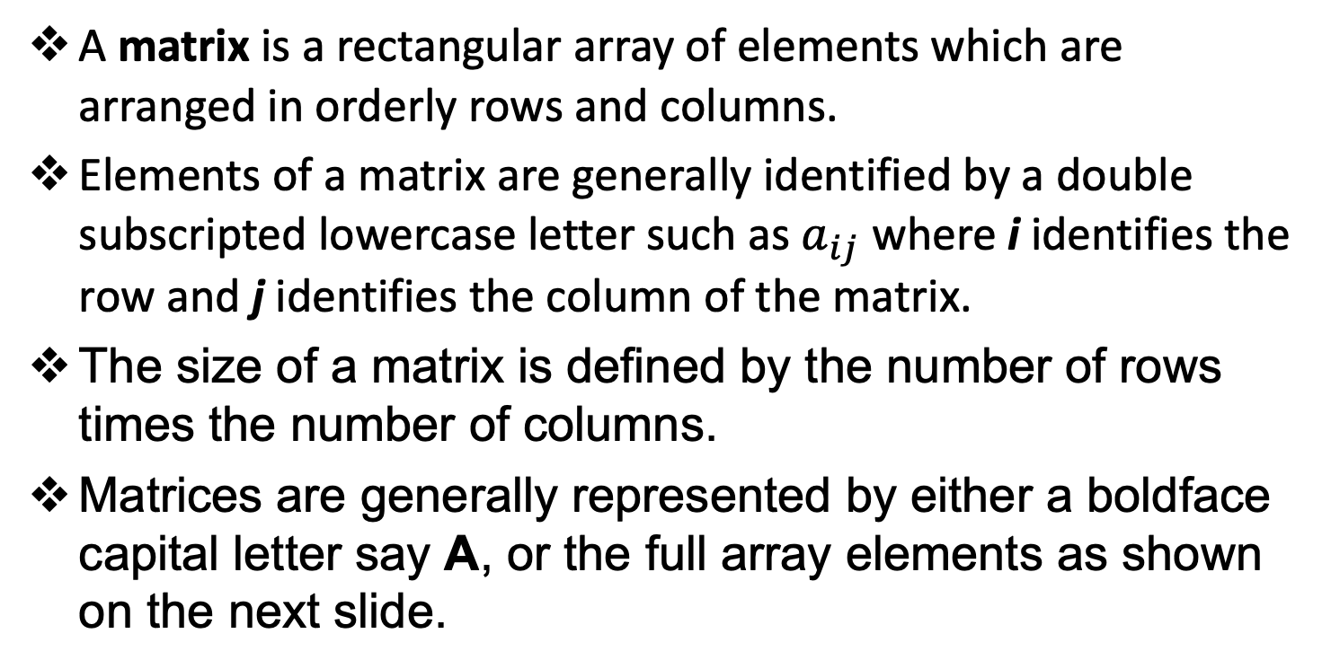
Matrix Definitions
A matrix is a rectangular array of elements which are arranged in orderly rows and columns.
Elements of a matrix are generally identified by a double subscripted lowercase letter such as $a_{ij}$ where i identifies the row and j identifies the column of the matrix.
The size of a matrix is defined by the number of rows times the number of columns.
Matrices are generally represented by either a boldface capital letter say A, or the full array elements as shown on the next slide.

Slide 12
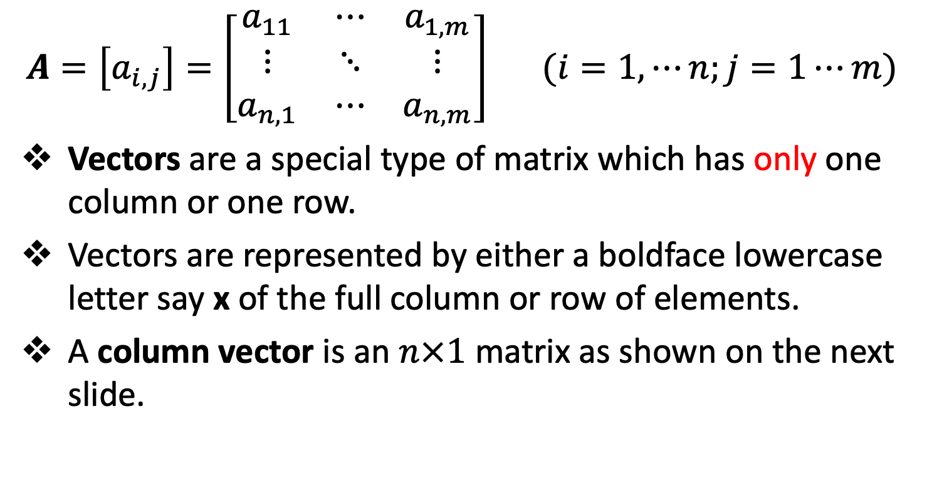
Matrix Definitions
$$A=\left[a_{i,j}\right]=\left[\begin{matrix}a_{11} & ⋯ & a_{1,m} \\ ⋮ & ⋱ & ⋮ \\ a_{n,1} & ⋯ & a_{n,m}\end{matrix}\right] (i=1,⋯n;j=1⋯m)$$
Vectors are a special type of matrix which has only one column or one row.
Vectors are represented by either a boldface lowercase letter say x of the full column or row of elements.
A column vector is an $n×1$ matrix as shown on the next slide.

Slide 13
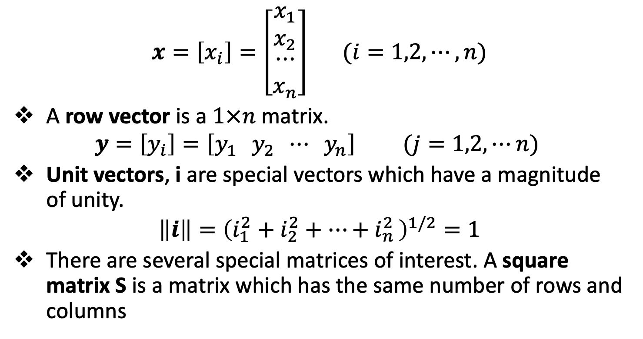
Matrix Definitions
$$x=\left[x_{i}\right]=\left[\begin{matrix}x_{1} \\ x_{2} \\ \begin{matrix}⋯ \\ x_{n}\end{matrix}\end{matrix}\right] (i=1,2,⋯,n)$$
A row vector is a $1×n$ matrix.
$$y=\left[y_{i}\right]=\left[y_{1 } y_{2} ⋯ y_{n}\right] (j=1,2,⋯n)$$
Unit vectors, i are special vectors which have a magnitude of unity.
$$\left\|i\right\|={\left(i_{1}^{2}+i_{2}^{2}+{⋯+i}_{n}^{2}\right)}^{1/2}=1$$
There are several special matrices of interest. A square matrix S is a matrix which has the same number of rows and columns

Slide 14
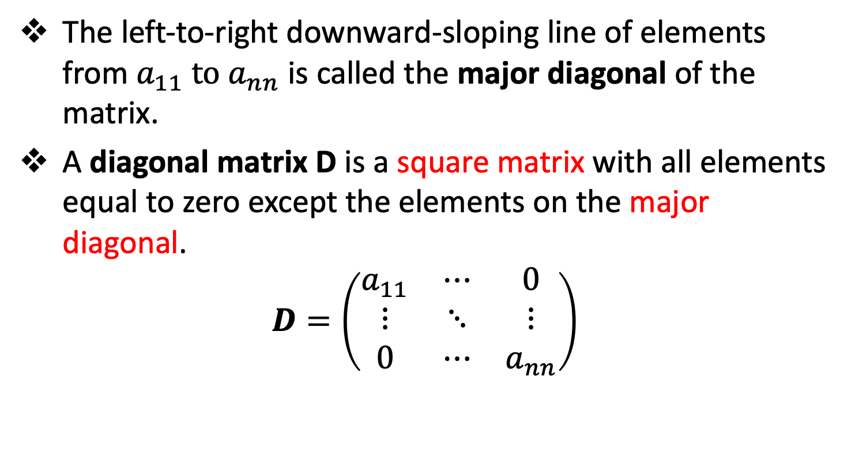
Matrix Definitions
The left-to-right downward-sloping line of elements from $a_{11} to a_{nn}$ is called the major diagonal of the matrix.
A diagonal matrix D is a square matrix with all elements equal to zero except the elements on the major diagonal.
$$D=\left(\begin{matrix}a_{11} & ⋯ & 0 \\ ⋮ & ⋱ & ⋮ \\ 0 & ⋯ & a_{nn}\end{matrix}\right)$$

Slide 15
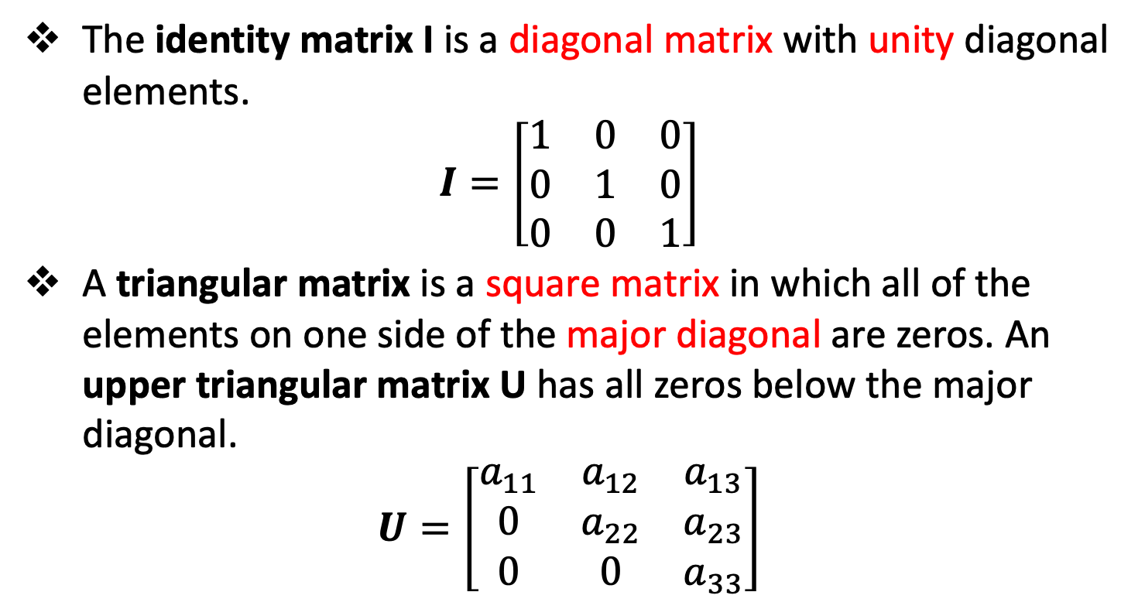
Matrix Definitions
The identity matrix I is a diagonal matrix with unity diagonal elements.
$$I=\left[\begin{matrix}1 & 0 & 0 \\ 0 & 1 & 0 \\ 0 & 0 & 1\end{matrix}\right]$$
A triangular matrix is a square matrix in which all of the elements on one side of the major diagonal are zeros. An upper triangular matrix U has all zeros below the major diagonal.
$$U=\left[\begin{matrix}a_{11} & a_{12} & a_{13} \\ 0 & a_{22} & a_{23} \\ 0 & 0 & a_{33}\end{matrix}\right]$$

Slide 16
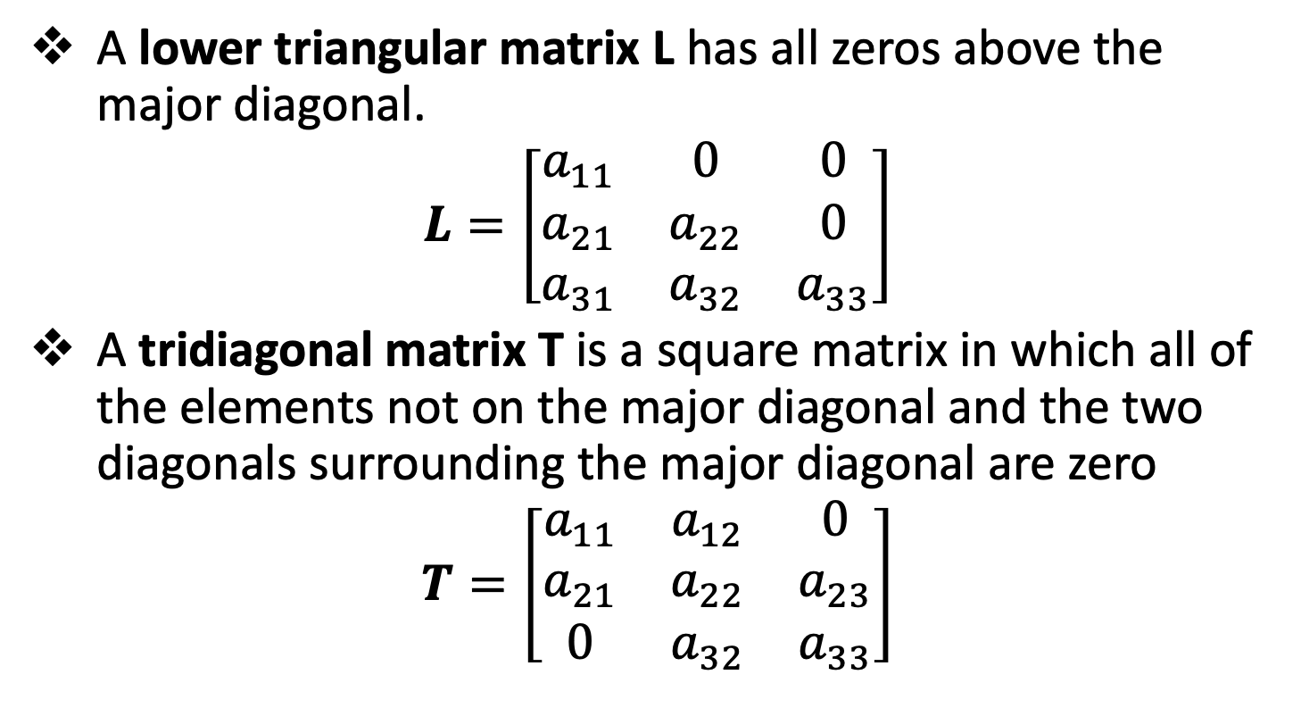
Matrix Definitions
A lower triangular matrix L has all zeros above the major diagonal.
$$L=\left[\begin{matrix}a_{11} & 0 & 0 \\ a_{21} & a_{22} & 0 \\ a_{31} & a_{32} & a_{33}\end{matrix}\right]$$
A tridiagonal matrix T is a square matrix in which all of the elements not on the major diagonal and the two diagonals surrounding the major diagonal are zero
$$T=\left[\begin{matrix}a_{11} & a_{12} & 0 \\ a_{21} & a_{22} & a_{23} \\ 0 & a_{32} & a_{33}\end{matrix}\right]$$

Slide 17
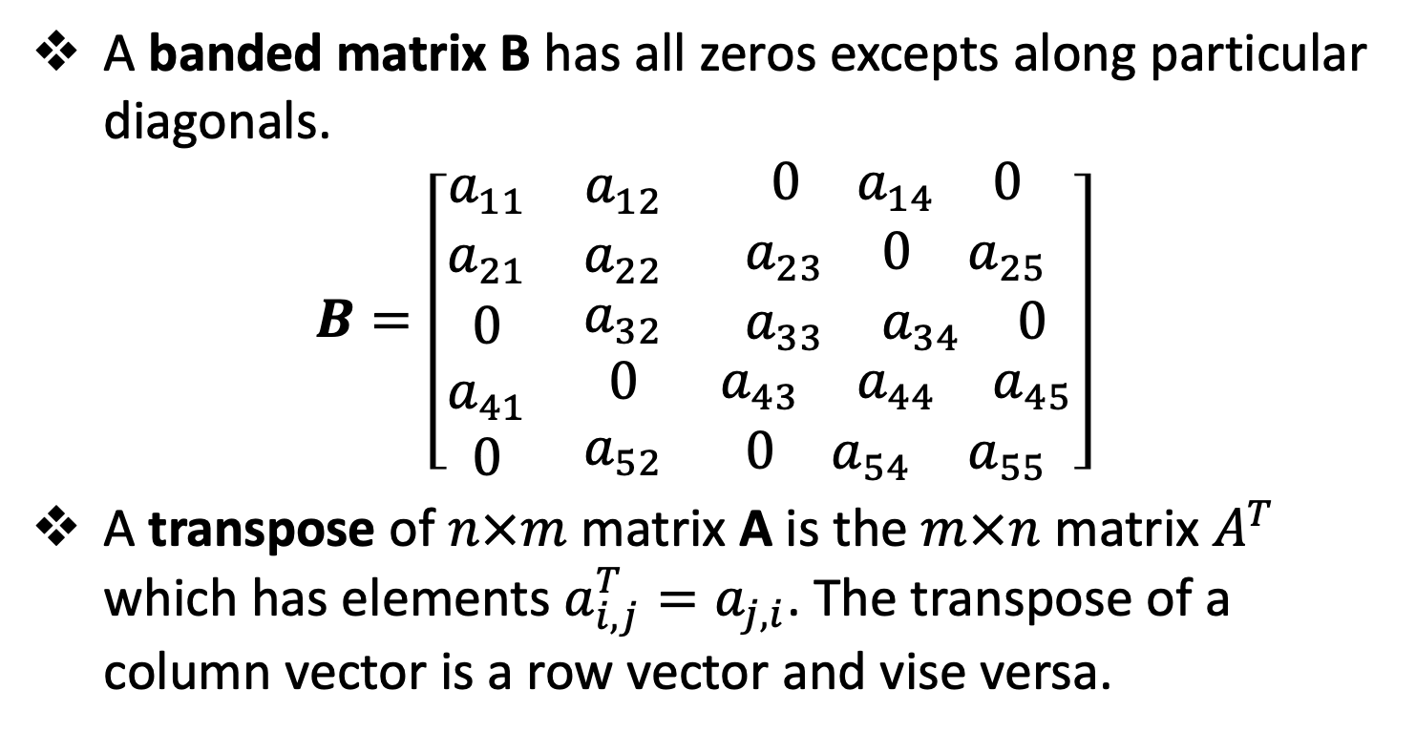
Matrix Definitions
A banded matrix B has all zeros excepts along particular diagonals.
$$B=\left[\begin{matrix}a_{11} & a_{12} & \begin{matrix}0 & a_{14} & 0\end{matrix} \\ a_{21} & a_{22} & \begin{matrix}a_{23} & 0 & a_{25}\end{matrix} \\ \begin{matrix}0 \\ a_{41} \\ 0\end{matrix} & \begin{matrix}a_{32} \\ 0 \\ a_{52}\end{matrix} & \begin{matrix}\begin{matrix}a_{33} & a_{34} & 0\end{matrix} \\ \begin{matrix}a_{43} & a_{44} & a_{45}\end{matrix} \\ \begin{matrix}0 & a_{54} & a_{55}\end{matrix}\end{matrix}\end{matrix}\right]$$
A transpose of $n×m$ matrix A is the $m×n$ matrix $A^{T}$ which has elements $a_{i,j}^{T}=a_{j,i}$. The transpose of a column vector is a row vector and vise versa.

Slide 18
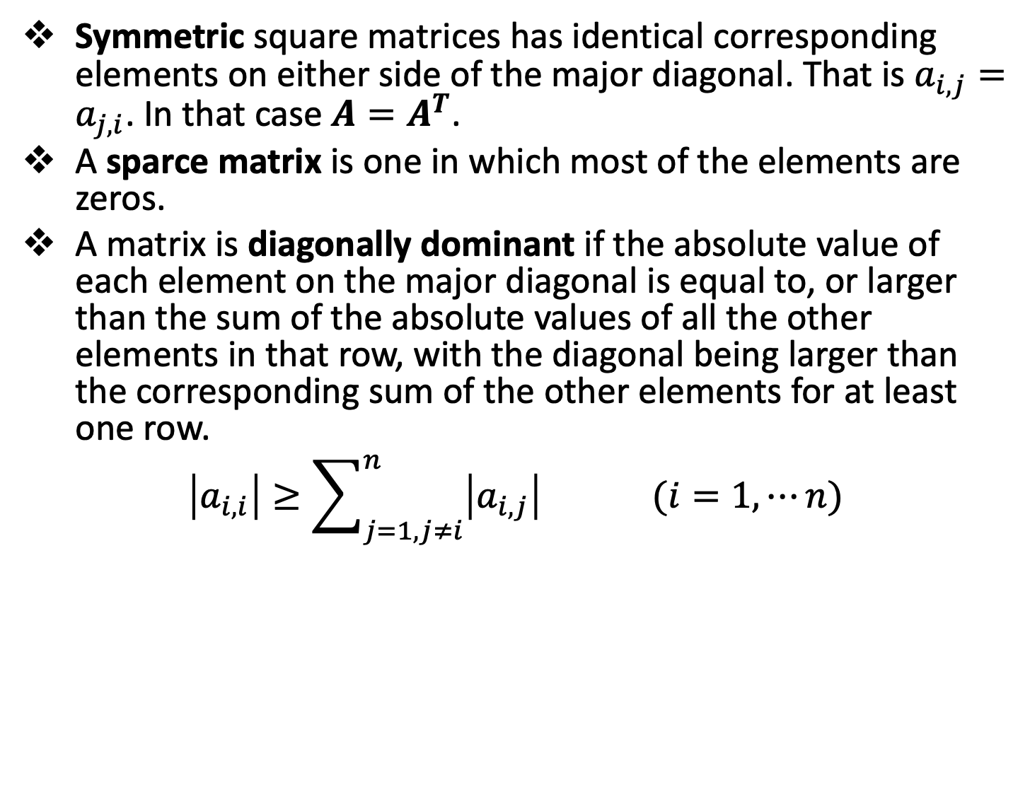
Matrix Definitions
Symmetric square matrices has identical corresponding elements on either side of the major diagonal. That is $a_{i,j}=a_{j,i}$. In that case $A=A^{T}$.
A sparce matrix is one in which most of the elements are zeros.
A matrix is diagonally dominant if the absolute value of each element on the major diagonal is equal to, or larger than the sum of the absolute values of all the other elements in that row, with the diagonal being larger than the corresponding sum of the other elements for at least one row.
$$\left|a_{i,i}\right|≥\sum_{j=1, j≠i}^{n}{\left|a_{i,j}\right| (i=1,⋯n) }$$

Slide 19
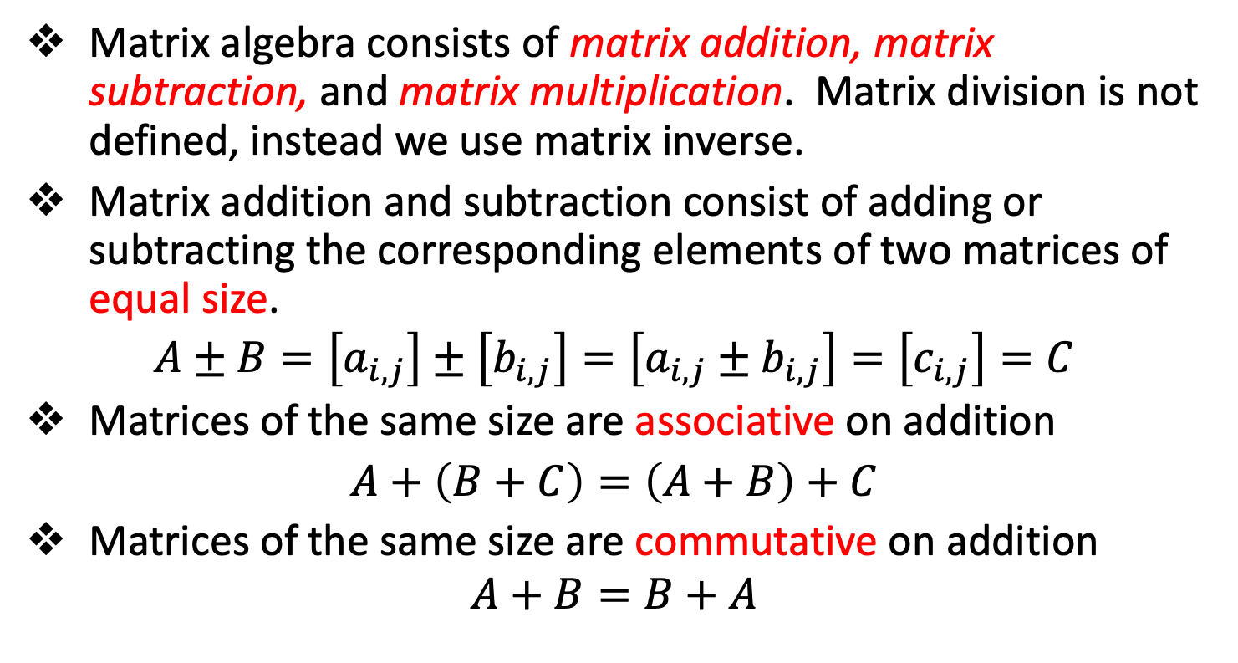
Matrix Algebra
Matrix algebra consists of matrix addition, matrix subtraction, and matrix multiplication. Matrix division is not defined, instead we use matrix inverse.
Matrix addition and subtraction consist of adding or subtracting the corresponding elements of two matrices of equal size.
$$A±B=\left[a_{i,j}\right]±\left[b_{i,j}\right]=\left[a_{i,j}±b_{i,j}\right]=\left[c_{i,j}\right]=C$$
Matrices of the same size are associative on addition
$A+\left(B+C\right)=\left(A+B\right)+C$
Matrices of the same size are commutative on addition
$$A+B=B+A$$

Slide 20
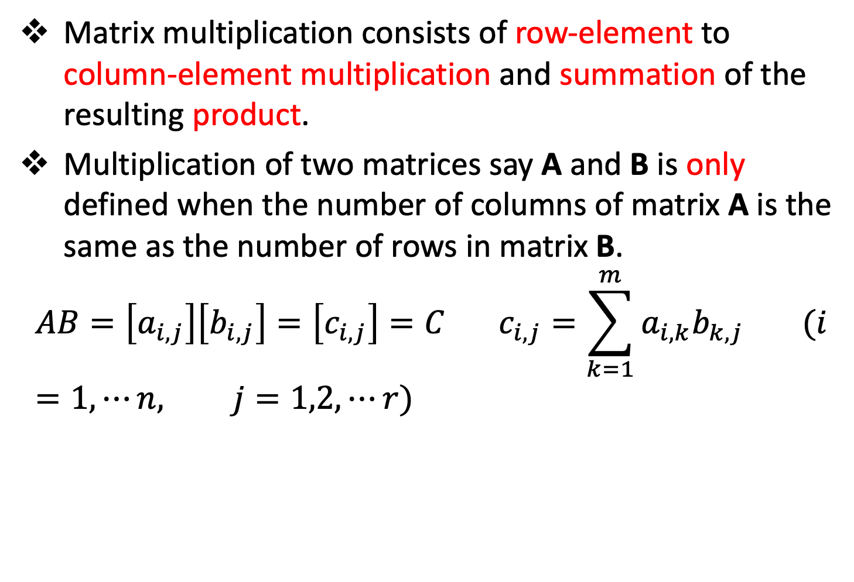
Matrix Algebra
Matrix multiplication consists of row-element to column-element multiplication and summation of the resulting product.
Multiplication of two matrices say A and B is only defined when the number of columns of matrix A is the same as the number of rows in matrix B.
$$AB=\left[a_{i,j}\right]\left[b_{i,j}\right]=\left[c_{i,j}\right]=C c_{i,j}=\sum_{k=1}^{m}{a_{i,k}b_{k,j}} (i=1,⋯n, j=1,2,⋯r)$$

Slide 21
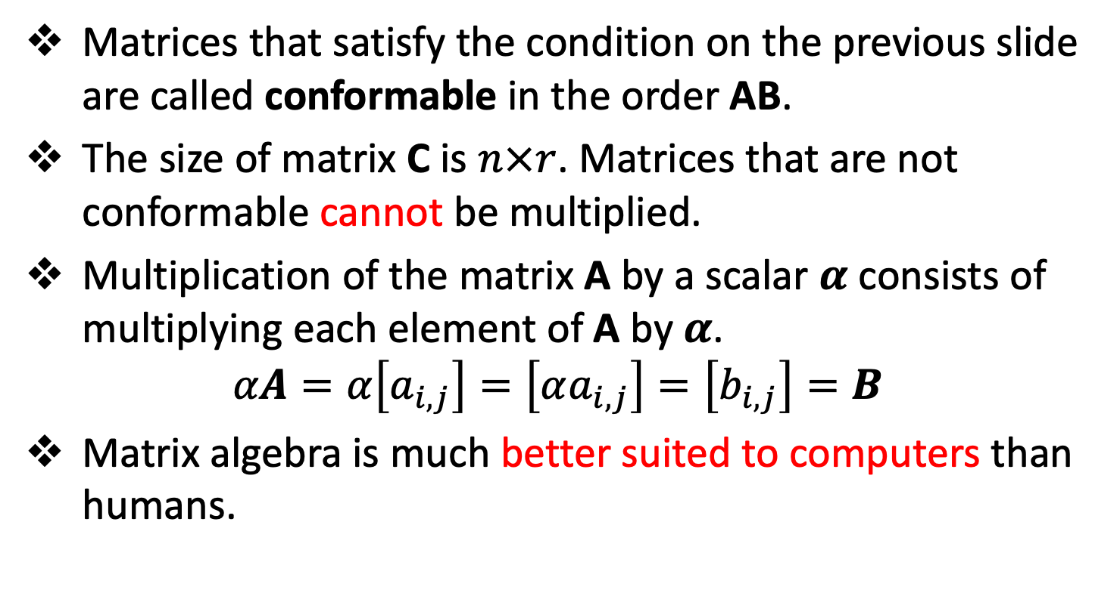
Matrix Algebra
Matrices that satisfy the condition on the previous slide are called conformable in the order AB.
The size of matrix C is $n×r$. Matrices that are not conformable cannot be multiplied.
Multiplication of the matrix A by a scalar $α$ consists of multiplying each element of A by $α$.
$$αA=α\left[a_{i,j}\right]=\left[αa_{i,j}\right]=\left[b_{i,j}\right]=B$$
Matrix algebra is much better suited to computers than humans.

Slide 22
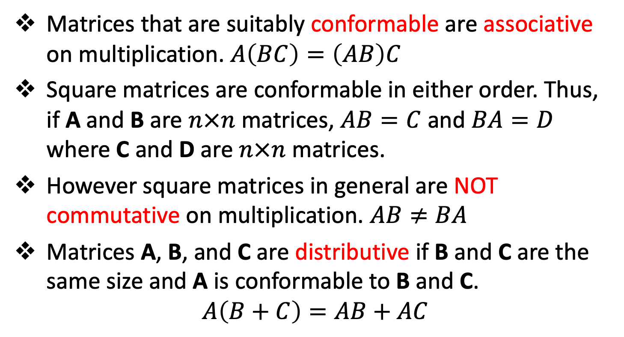
Matrix Algebra
Matrices that are suitably conformable are associative on multiplication. $A\left(BC\right)=\left(AB\right)C$
Square matrices are conformable in either order. Thus, if A and B are $n×n$ matrices, $AB=C$ and $BA=D$ where C and D are $n×n$ matrices.
However square matrices in general are NOT commutative on multiplication. $AB≠BA$
Matrices A, B, and C are distributive if B and C are the same size and A is conformable to B and C.
$$A\left(B+C\right)=AB+AC$$

Slide 23
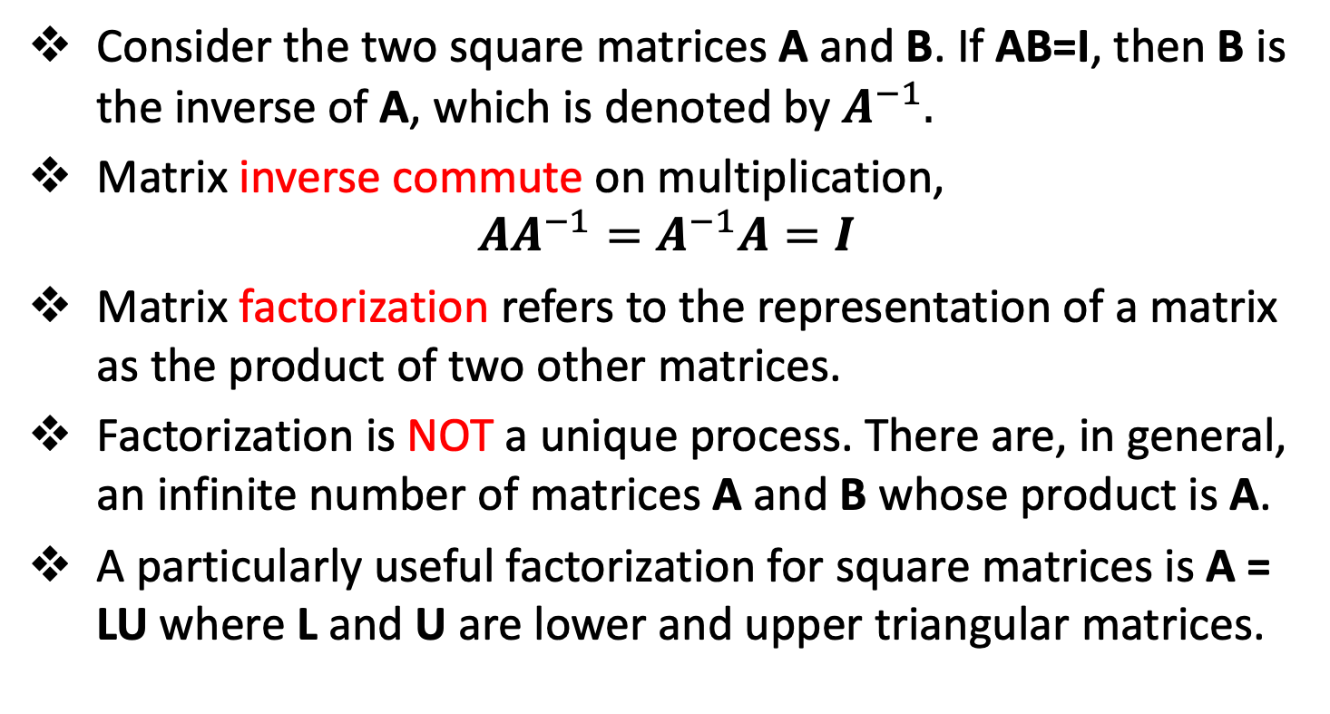
Matrix Algebra
Consider the two square matrices A and B. If AB=I, then B is the inverse of A, which is denoted by $A^{−1}.$
Matrix inverse commute on multiplication,
$$AA^{−1}=A^{−1}A=I$$
Matrix factorization refers to the representation of a matrix as the product of two other matrices.
Factorization is NOT a unique process. There are, in general, an infinite number of matrices A and B whose product is A.
A particularly useful factorization for square matrices is A = LU where L and U are lower and upper triangular matrices.

Slide 24
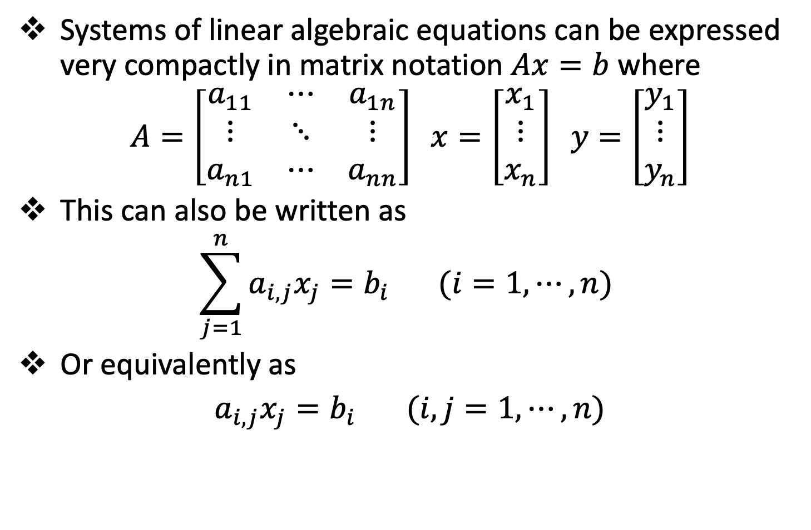
Systems of Linear Algebraic Equations
Systems of linear algebraic equations can be expressed very compactly in matrix notation $Ax=b$ where
$$A=\left[\begin{matrix}a_{11} & ⋯ & a_{1n} \\ ⋮ & ⋱ & ⋮ \\ a_{n1} & ⋯ & a_{nn}\end{matrix}\right] x=\left[\begin{matrix}x_{1} \\ ⋮ \\ x_{n}\end{matrix}\right] y=\left[\begin{matrix}y_{1} \\ ⋮ \\ y_{n}\end{matrix}\right]$$
This can also be written as
$$\sum_{j=1}^{n}{a_{i,j}x_{j}=b_{i}} (i=1,⋯,n)$$
Or equivalently as
$a_{i,j}x_{j}=b_{i} (i,j=1,⋯,n)$

Slide 25
Systems of Linear Algebraic Equations
There are three row operations that are useful when solving systems of linear algebraic equations. They are:
Any row may be multiplied by a constant (a process called scaling)
The order of the rows may be interchanged (a process called pivoting)
Any row can be replaced by a weighted linear combination of that row with any other row (a process called elimination)

Slide 26
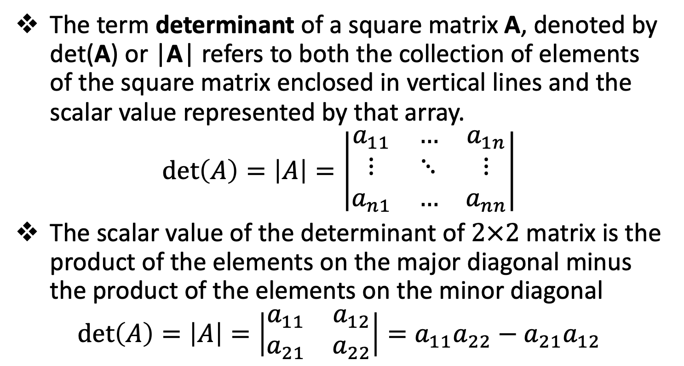
Determinants
The term determinant of a square matrix A, denoted by det(A) or |A| refers to both the collection of elements of the square matrix enclosed in vertical lines and the scalar value represented by that array.
$$\det\left(A\right)=\left|A\right|=\left|\begin{matrix}a_{11} & … & a_{1n} \\ ⋮ & ⋱ & ⋮ \\ a_{n1} & … & a_{nn}\end{matrix}\right|$$
The scalar value of the determinant of $2×2$ matrix is the product of the elements on the major diagonal minus the product of the elements on the minor diagonal
$$\det\left(A\right)=\left|A\right|=\left|\begin{matrix}a_{11} & a_{12} \\ a_{21} & a_{22}\end{matrix}\right|=a_{11}a_{22}−a_{21}a_{12}$$

Slide 27
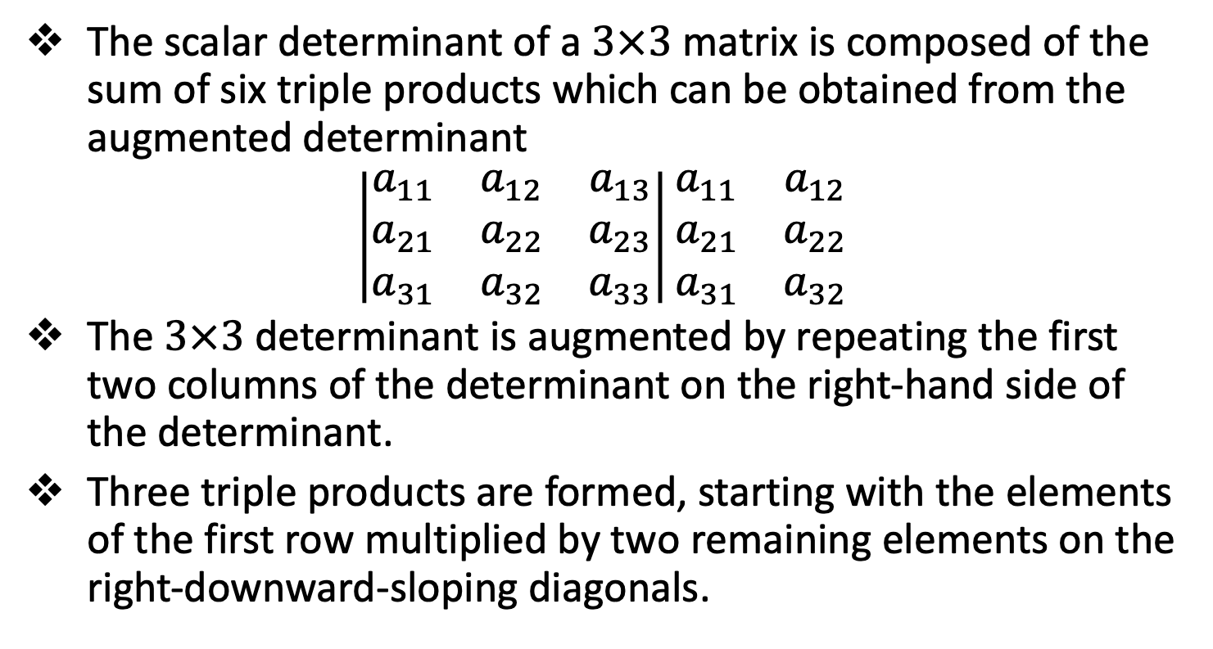
Determinants
The scalar determinant of a $3×3$ matrix is composed of the sum of six triple products which can be obtained from the augmented determinant
$$\left|\begin{matrix}a_{11} & a_{12} & a_{13} \\ a_{21} & a_{22} & a_{23} \\ a_{31} & a_{32} & a_{33}\end{matrix}\right|\begin{matrix}a_{11} & a_{12} \\ a_{21} & a_{22} \\ a_{31} & a_{32}\end{matrix}$$
The $3×3$ determinant is augmented by repeating the first two columns of the determinant on the right-hand side of the determinant.
Three triple products are formed, starting with the elements of the first row multiplied by two remaining elements on the right-downward-sloping diagonals.

Slide 28
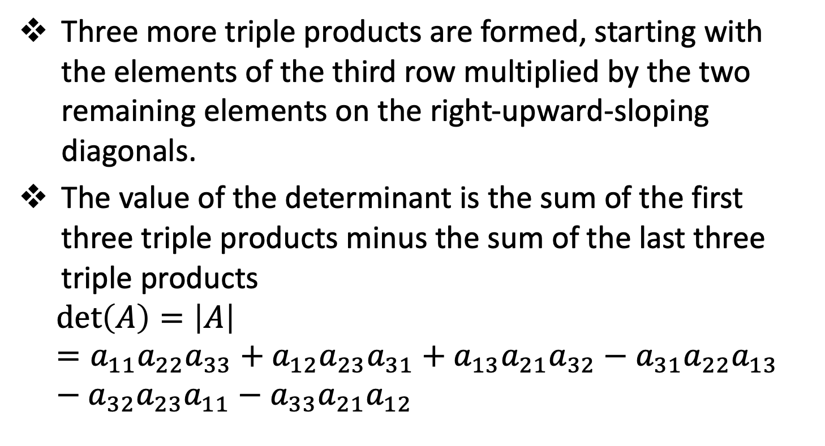
Determinants
Three more triple products are formed, starting with the elements of the third row multiplied by the two remaining elements on the right-upward-sloping diagonals.
The value of the determinant is the sum of the first three triple products minus the sum of the last three triple products
$$\det\left(A\right)=\left|A\right|=a_{11}a_{22}a_{33}+a_{12}a_{23}a_{31}+a_{13}a_{21}a_{32}−a_{31}a_{22}a_{13}−a_{32}a_{23}a_{11}−a_{33}a_{21}a_{12}$$

Slide 29
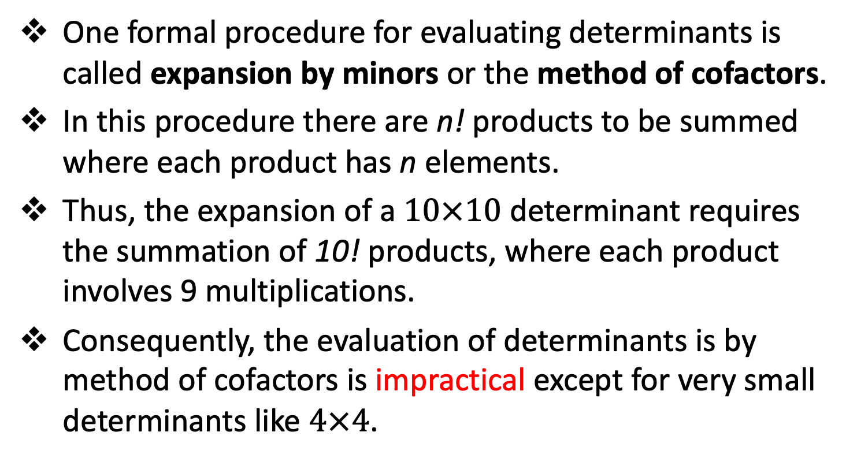
Determinants
One formal procedure for evaluating determinants is called expansion by minors or the method of cofactors.
In this procedure there are n! products to be summed where each product has n elements.
Thus, the expansion of a $10×10$ determinant requires the summation of 10! products, where each product involves 9 multiplications.
Consequently, the evaluation of determinants is by method of cofactors is impractical except for very small determinants like $4×4$.

Slide 30
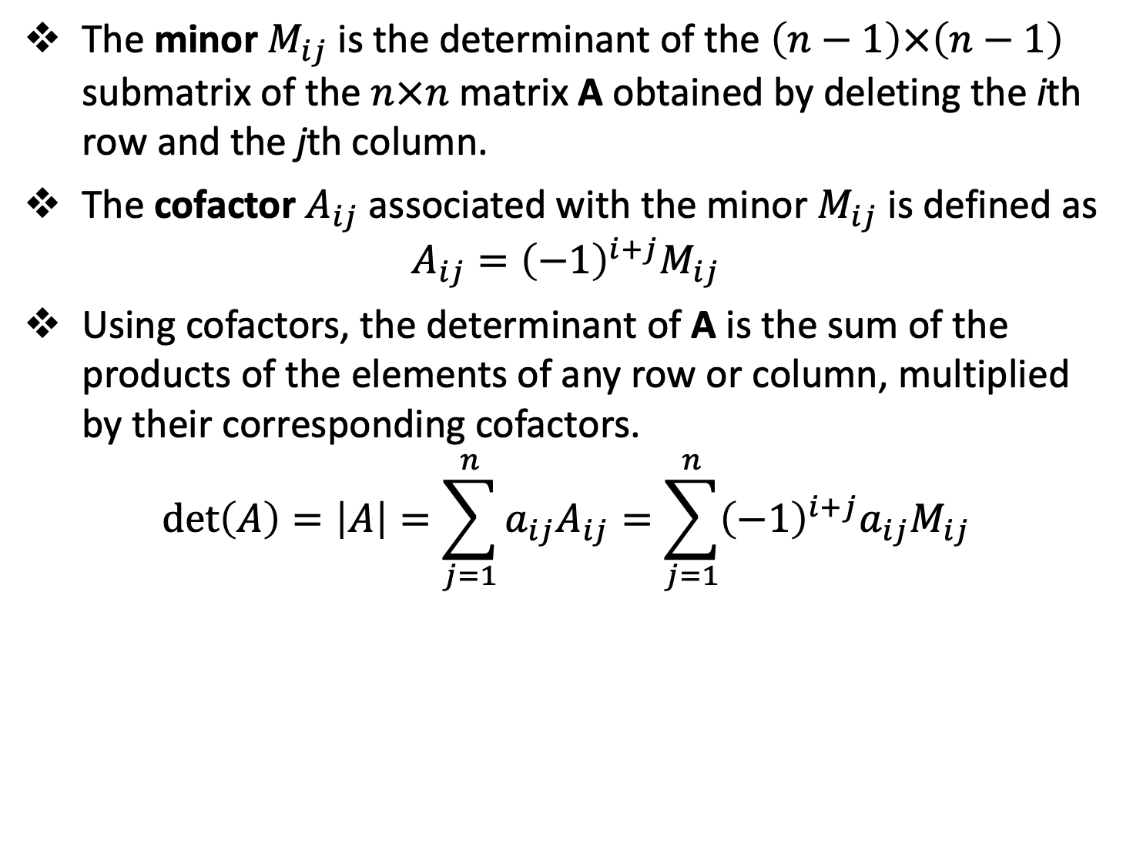
Determinants
The minor $M_{ij}$ is the determinant of the $\left(n−1\right)×\left(n−1\right)$ submatrix of the $n×n$ matrix A obtained by deleting the ith row and the jth column.
The cofactor $A_{ij}$associated with the minor $M_{ij}$ is defined as
$$A_{ij}={\left(−1\right)}^{i+j}M_{ij}$$
Using cofactors, the determinant of A is the sum of the products of the elements of any row or column, multiplied by their corresponding cofactors.
$$\det\left(A\right)=\left|A\right|=\sum_{j=1}^{n}{a_{ij}A_{ij}}=\sum_{j=1}^{n}{{\left(−1\right)}^{i+j}a_{ij}M_{ij}}$$

Slide 31
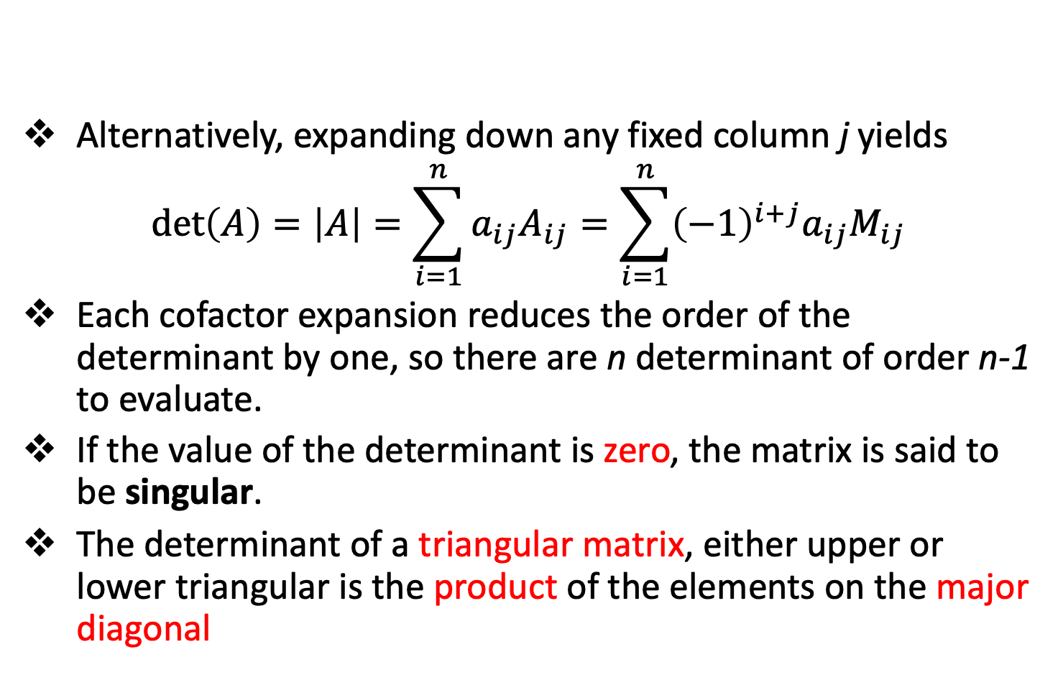
Determinants
Alternatively, expanding down any fixed column j yields
$$\det\left(A\right)=\left|A\right|=\sum_{i=1}^{n}{a_{ij}A_{ij}}=\sum_{i=1}^{n}{{\left(−1\right)}^{i+j}a_{ij}M_{ij}}$$
Each cofactor expansion reduces the order of the determinant by one, so there are n determinant of order n-1 to evaluate.
If the value of the determinant is zero, the matrix is said to be singular.
The determinant of a triangular matrix, either upper or lower triangular is the product of the elements on the major diagonal

Slide 32
Direct Elimination methods
Topic Two

Slide 33
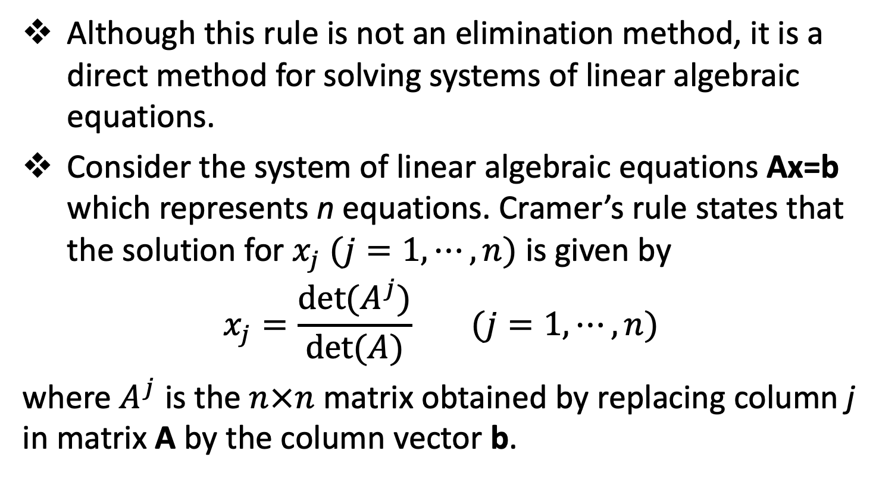
Cramer’s Rule
Although this rule is not an elimination method, it is a direct method for solving systems of linear algebraic equations.
Consider the system of linear algebraic equations Ax=b which represents n equations. Cramer’s rule states that the solution for $x_{j} (j=1,⋯,n)$ is given by
$$x_{j}=\frac{det⁡(A^{j})}{det⁡(A)} (j=1,⋯,n)$$
where $A^{j}$ is the $n×n$ matrix obtained by replacing column j in matrix A by the column vector b.

Slide 34
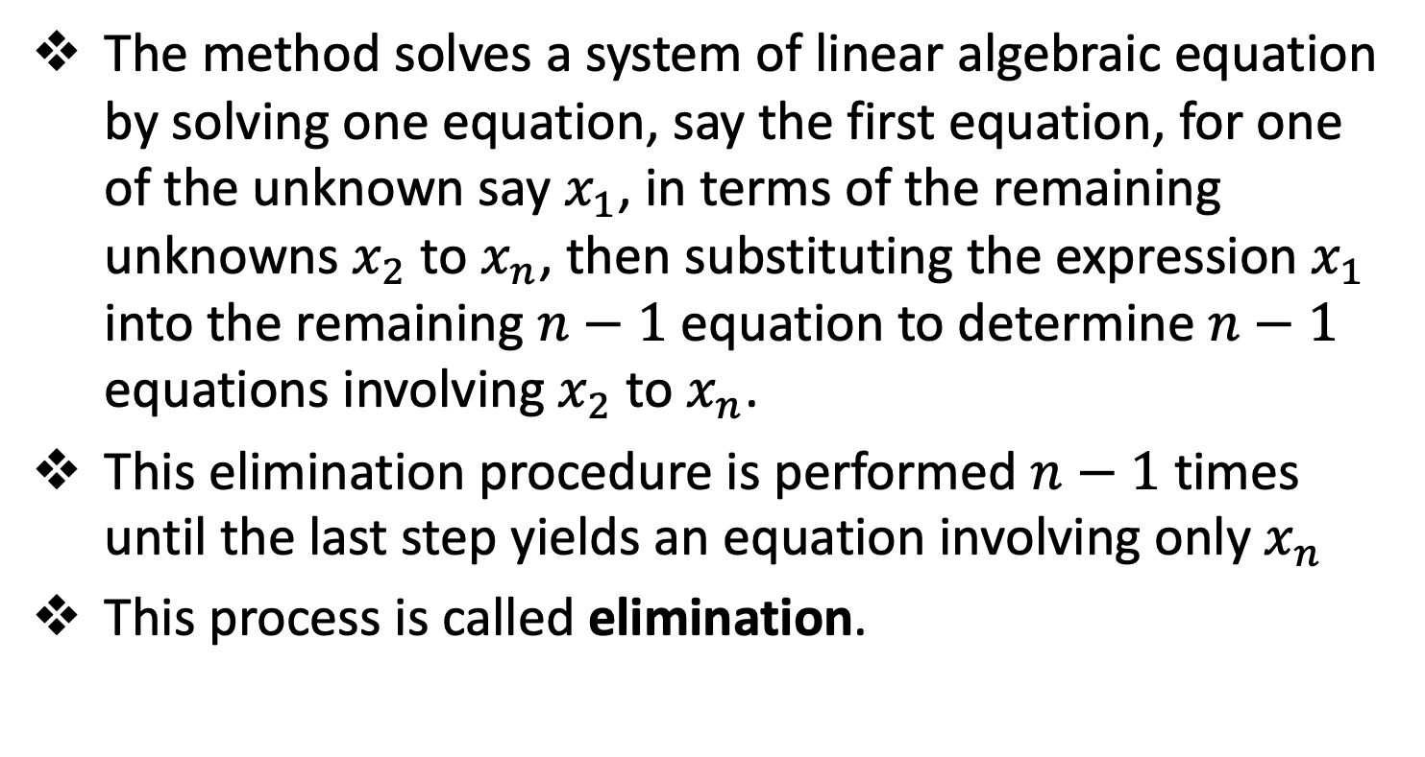
Elimination Methods-Simple
The method solves a system of linear algebraic equation by solving one equation, say the first equation, for one of the unknown say $x_{1}$, in terms of the remaining unknowns $x_{2}$ to $x_{n}$, then substituting the expression $x_{1}$ into the remaining $n−1$ equation to determine $n−1$ equations involving $x_{2}$ to $x_{n}$.
This elimination procedure is performed $n−1$ times until the last step yields an equation involving only $x_{n}$
This process is called elimination.

Slide 35
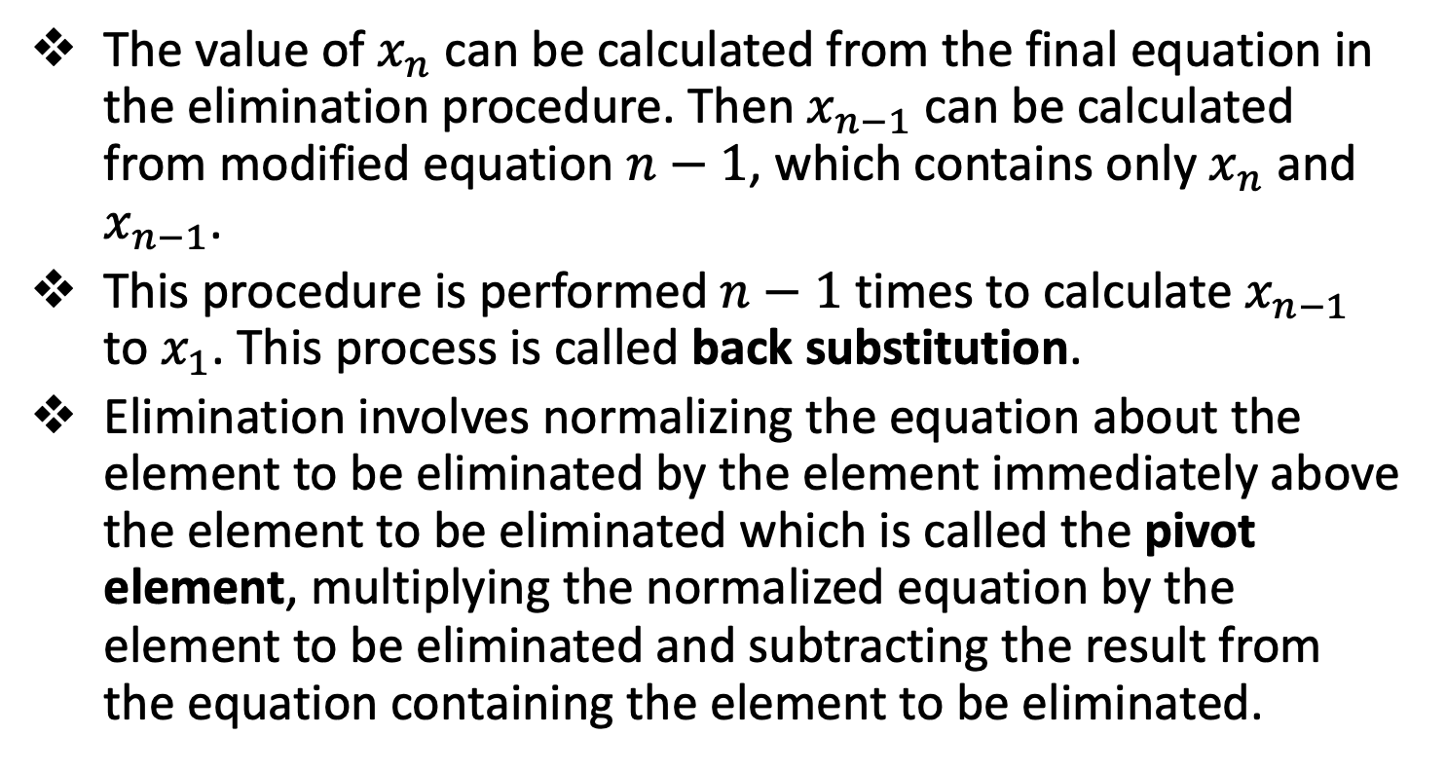
Elimination Methods-Simple
The value of $x_{n}$ can be calculated from the final equation in the elimination procedure. Then $x_{n−1}$ can be calculated from modified equation $n−1$, which contains only $x_{n}$ and $x_{n−1}$.
This procedure is performed $n−1$ times to calculate $x_{n−1}$ to $x_{1}$. This process is called back substitution.
Elimination involves normalizing the equation about the element to be eliminated by the element immediately above the element to be eliminated which is called the pivot element, multiplying the normalized equation by the element to be eliminated and subtracting the result from the equation containing the element to be eliminated.

Slide 36
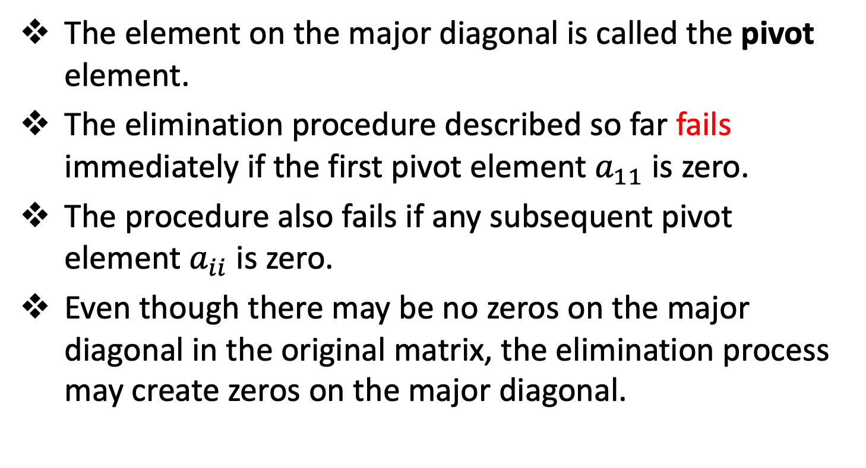
Elimination Methods-Pivoting
The element on the major diagonal is called the pivot element.
The elimination procedure described so far fails immediately if the first pivot element $a_{11}$ is zero.
The procedure also fails if any subsequent pivot element $a_{ii}$ is zero.
Even though there may be no zeros on the major diagonal in the original matrix, the elimination process may create zeros on the major diagonal.

Slide 37
Elimination Methods-Pivoting
The zeros on the major diagonal can be avoided by rearranging the equations, by interchanging the rows or columns before each elimination step.
This process is called pivoting.
Interchanging both rows and columns is called full pivoting. Interchanging only rows is called partial pivoting.
Pivoting reduces round-off errors since the pivot element is a divisor during the elimination process, and division by large numbers introduces smaller round-off errors.

Slide 38
Elimination Methods-Scaling
The simple elimination also incur significant round-off errors when the magnitudes of the pivot elements are smaller than the magnitudes of the other elements in the equations containing the pivot elements.
In such cases scaling is employed to select the pivot element. Scaling is employed only to select the pivot elements.
After pivoting, elimination is applied to the original equations
The elimination procedure described so far is commonly called Gauss Elimination

Slide 39
Gauss-Jordan Elimination
Gauss-Jordan elimination is a variation of Gauss elimination in which the elements above the major diagonal are eliminated as well as the elements below the major diagonal.
The A matrix is transformed to a diagonal matrix.
The rows are usually scaled to yield unity diagonal elements which transforms the A matrix to the identity matrix I.
The transformed b vector is then the solution vector x.

Slide 40
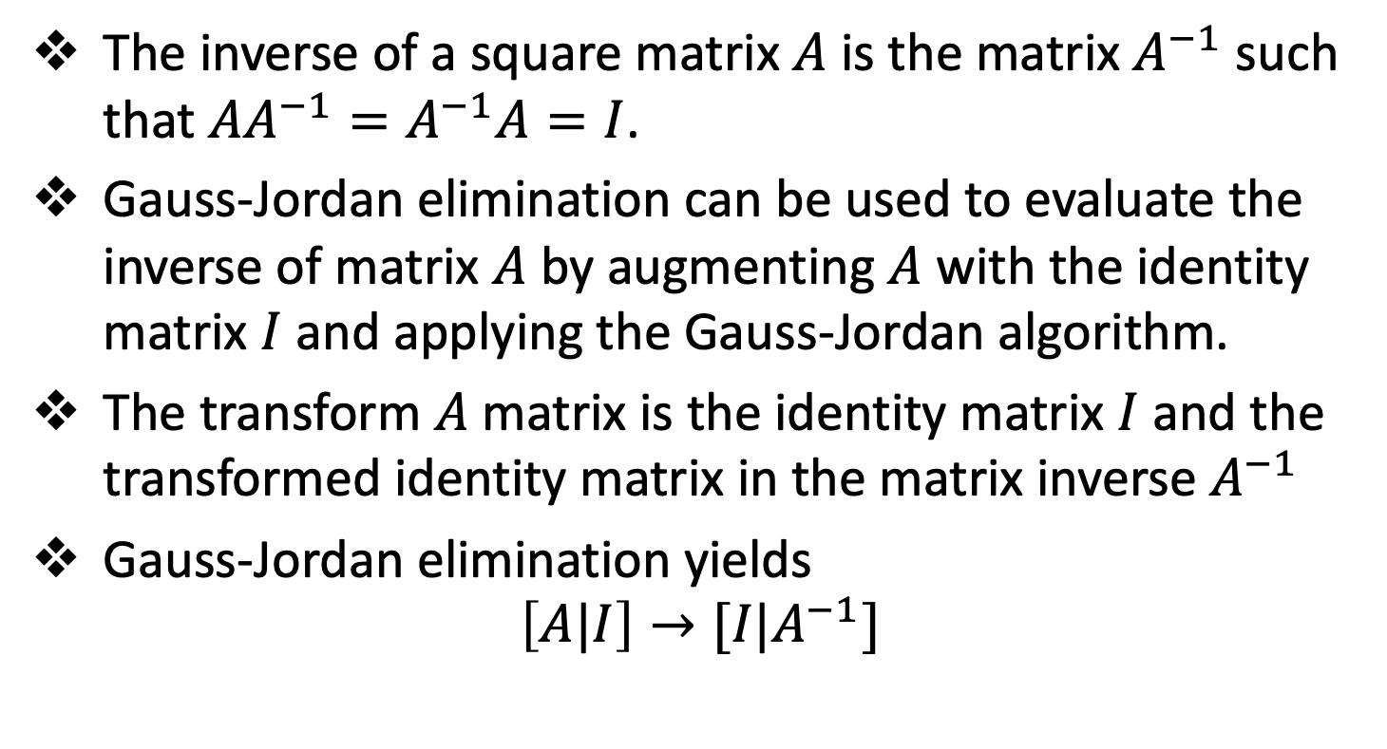
Gauss-Jordan Elimination
The inverse of a square matrix $A$ is the matrix $A^{−1}$ such that $AA^{−1}=A^{−1}A=I$.
Gauss-Jordan elimination can be used to evaluate the inverse of matrix $A$ by augmenting $A$ with the identity matrix $I$ and applying the Gauss-Jordan algorithm.
The transform $A$ matrix is the identity matrix $I$ and the transformed identity matrix in the matrix inverse $A^{−1}$
Gauss-Jordan elimination yields
$$\left[A|I\right]→[I|A^{−1}]$$

Slide 41
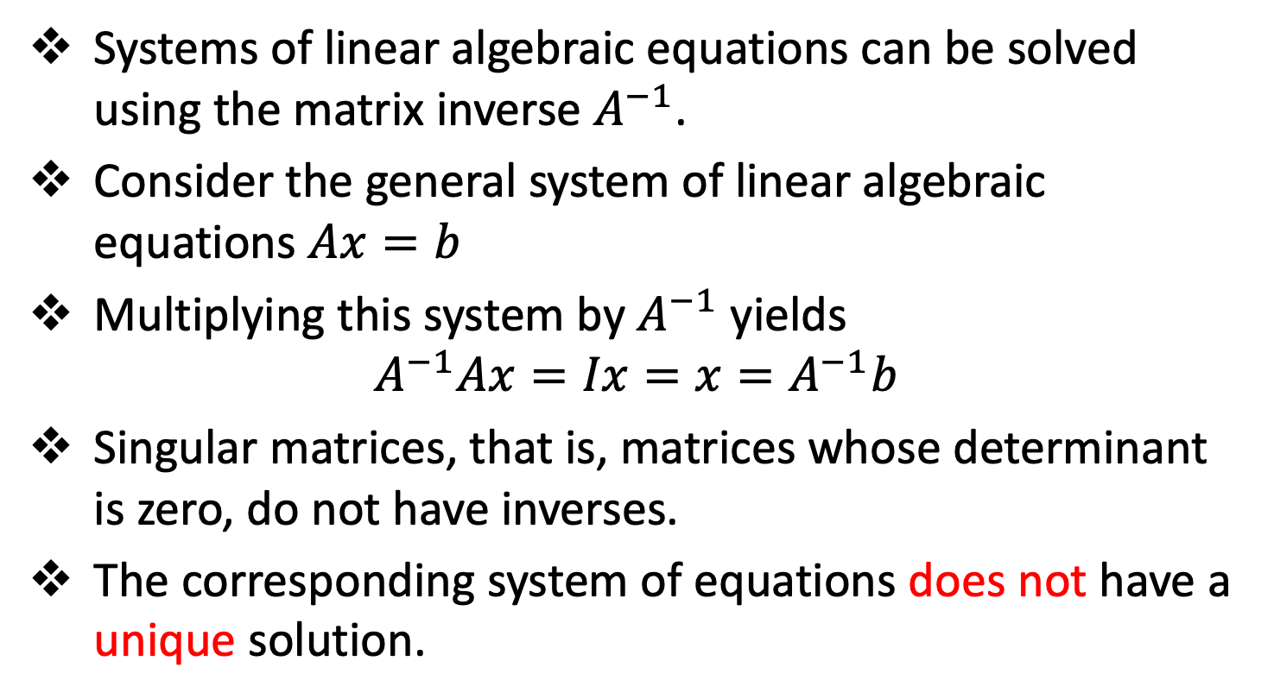
The Matrix Inverse Method
Systems of linear algebraic equations can be solved using the matrix inverse $A^{−1}$.
Consider the general system of linear algebraic equations $Ax=b$
Multiplying this system by $A^{−1}$ yields
$$A^{−1}Ax=Ix=x=A^{−1}b$$
Singular matrices, that is, matrices whose determinant is zero, do not have inverses.
The corresponding system of equations does not have a unique solution.

Slide 42
LU Factorization
Topic Three

Slide 43
LU Factorization
Matrices like scalars can be factored into the product of two other matrices in an infinite number of ways.
Thus, A = BC, when B and C are lower and upper triangular matrices respectively becomes A = LU.
Specifying the diagonal elements of either L or U makes the factoring unique.
The procedure based on unity elements on the major diagonal of L is called Doolitle method.
The procedure based on unity elements on the major diagonal of U is called Crout method.

Slide 44
LU Factorization
Matrices factoring can be used to reduced the work involved in Gauss elimination when multiple unknown b vectors are to be considered.
In Doolitle LU method, this is accomplished by defining the elimination multipliers determined in the elimination step of Gauss elimination as the elements of the L matrix.
The U matrix is defined as the upper triangular matrix determined by the elimination step of Gauss elimination.

Slide 45
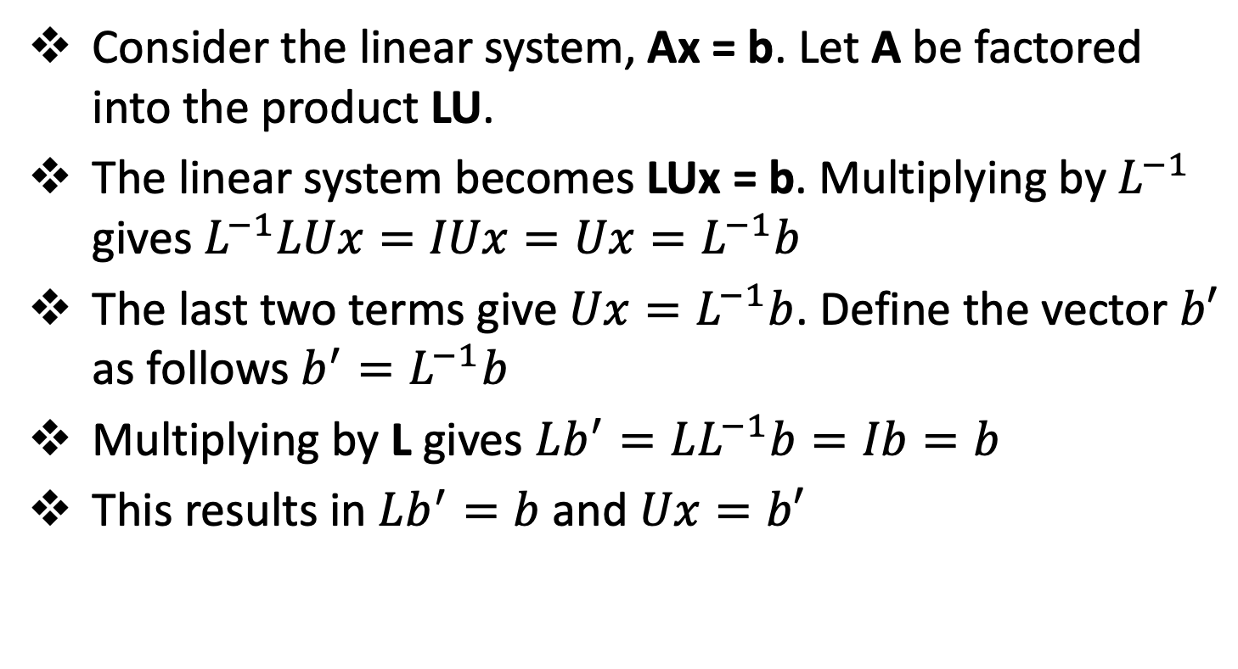
LU Factorization
Consider the linear system, Ax = b. Let A be factored into the product LU.
The linear system becomes LUx = b. Multiplying by $L^{−1}$ gives $L^{−1}LUx=IUx=Ux=L^{−1}b$
The last two terms give ${Ux=L}^{−1}b$. Define the vector $b′$ as follows $b^{′}=L^{−1}b$
Multiplying by L gives $Lb^{′}=LL^{−1}b=Ib=b$
This results in $Lb^{′}=b$ and $Ux=b′$

Slide 46
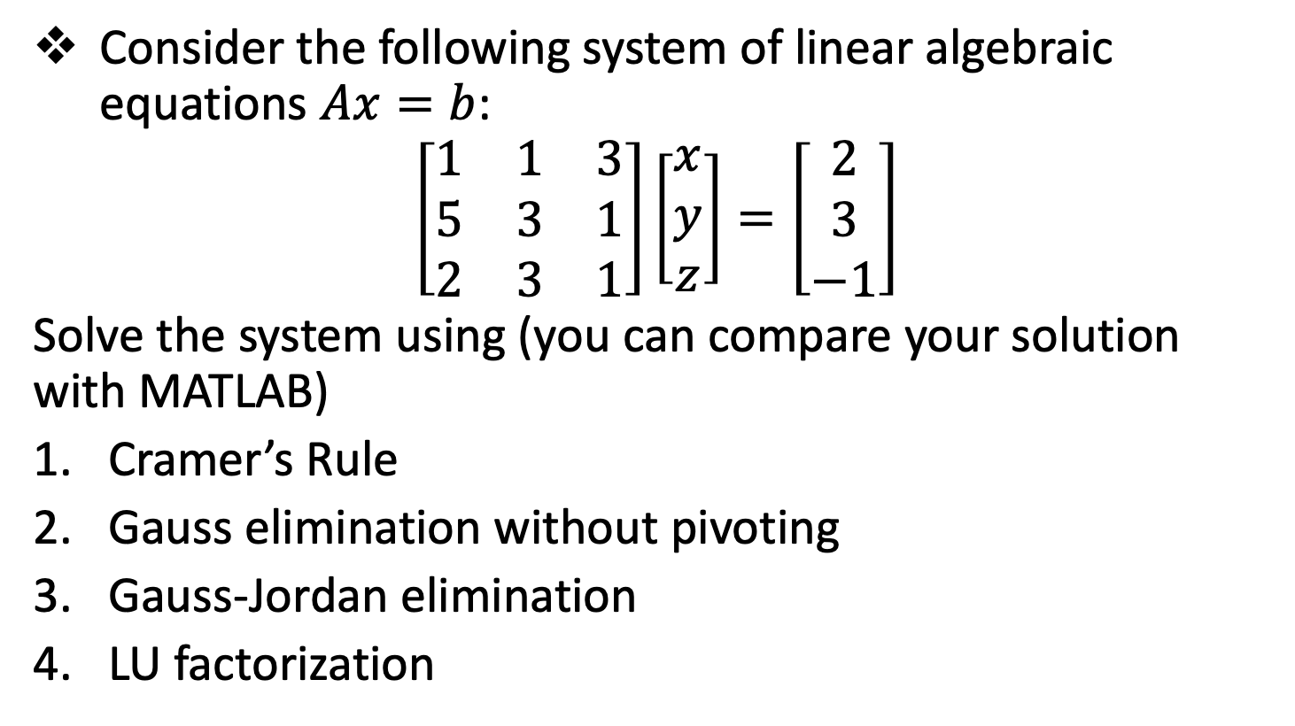
Session 1 - Assignment
Consider the following system of linear algebraic equations $Ax=b$:
$$\left[\begin{matrix}1 & 1 & 3 \\ 5 & 3 & 1 \\ 2 & 3 & 1\end{matrix}\right]\left[\begin{matrix}x \\ y \\ z\end{matrix}\right]=\left[\begin{matrix}2 \\ 3 \\ −1\end{matrix}\right]$$
Solve the system using (you can compare your solution with MATLAB)
Cramer’s Rule
Gauss elimination without pivoting
Gauss-Jordan elimination
LU factorization

Slide 47
Reference
Hoffman, J. D. (2001), Numerical Methods for Engineers and Scientists (2nd Edition)
Johnston, R. L. (1982), Numerical Methods, A Software Approach, John Wiley & Sons
Kahaner, D., Moler, C., and Nash S. (1989), Numerical Methods and Software, Prentice Hall.

Slide 48
The End

